Slide 1
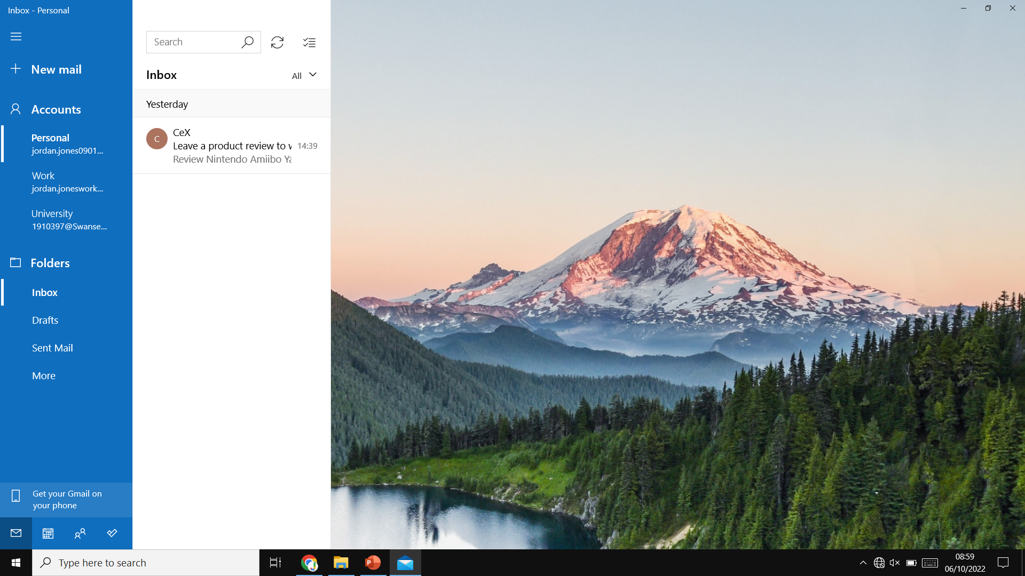
Introduction Screen
Accounts
Pers|
jordan.jones090…
Change Nickname
Logout
Work
jordan.joneswor…
University
1910397@swan…
University
1910397@swan…
School
jordan.jones12…
+ Login
Options
+ Create
Inbox
Drafts
Sent
Spam
Bin
Work
jordan.joneswor…

Slide 2




Login Screen
Accounts
Personal
jordan.jones090…
Google
Google Pop-Up
Work
jordan.joneswor…
Exchange/Office 365
Microsoft Pop-Up
University
1910397@swan…
University
1910397@swan…
Outlook
Microsoft Pop-Up
School
jordan.jones12…
Yahoo
Yahoo Pop-Up
+ Login
Options
+ Create
Inbox
Drafts
Sent
Spam
Bin
Other

Slide 3
Login Screen w/ Other Pop-Up
Accounts
Personal
jordan.jones090…
Google
Work
jordan.joneswor…
Exchange/Office 365
University
1910397@swan…
University
1910397@swan…
Outlook
School
jordan.jones12…
Yahoo
Email Address
+ Login
Options
+ Create
Inbox
Drafts
Sent
Spam
Bin
Password
Might Require an App-Specific Password for the given Email Account Provider
Other
Show Password
Login
Cancel

